Slide 1

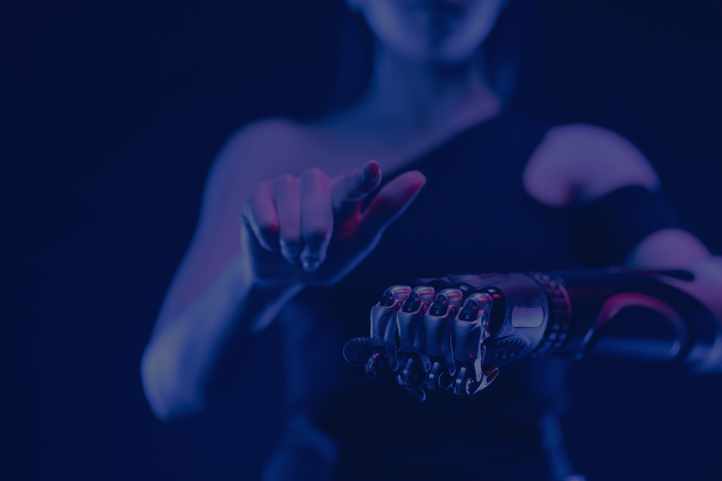
Diabetes
Prediction
Diabetes Prediction using
Machine Learning and
Deep Learning
By
Nion Rahaman Akash
SHOHA TAMANNA

Slide 2

Thank you
Assistant Professor
Afzal Hossain

Slide 3
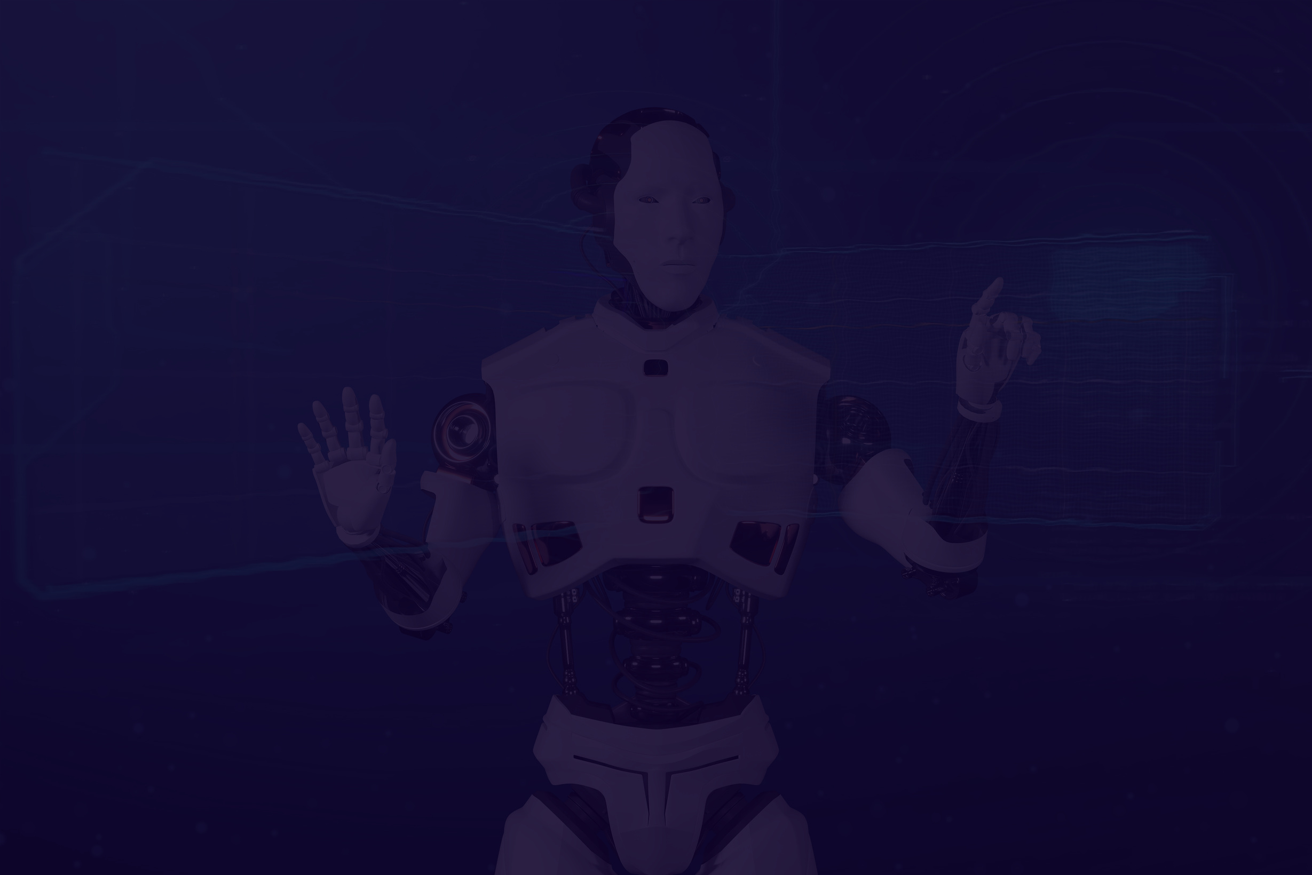
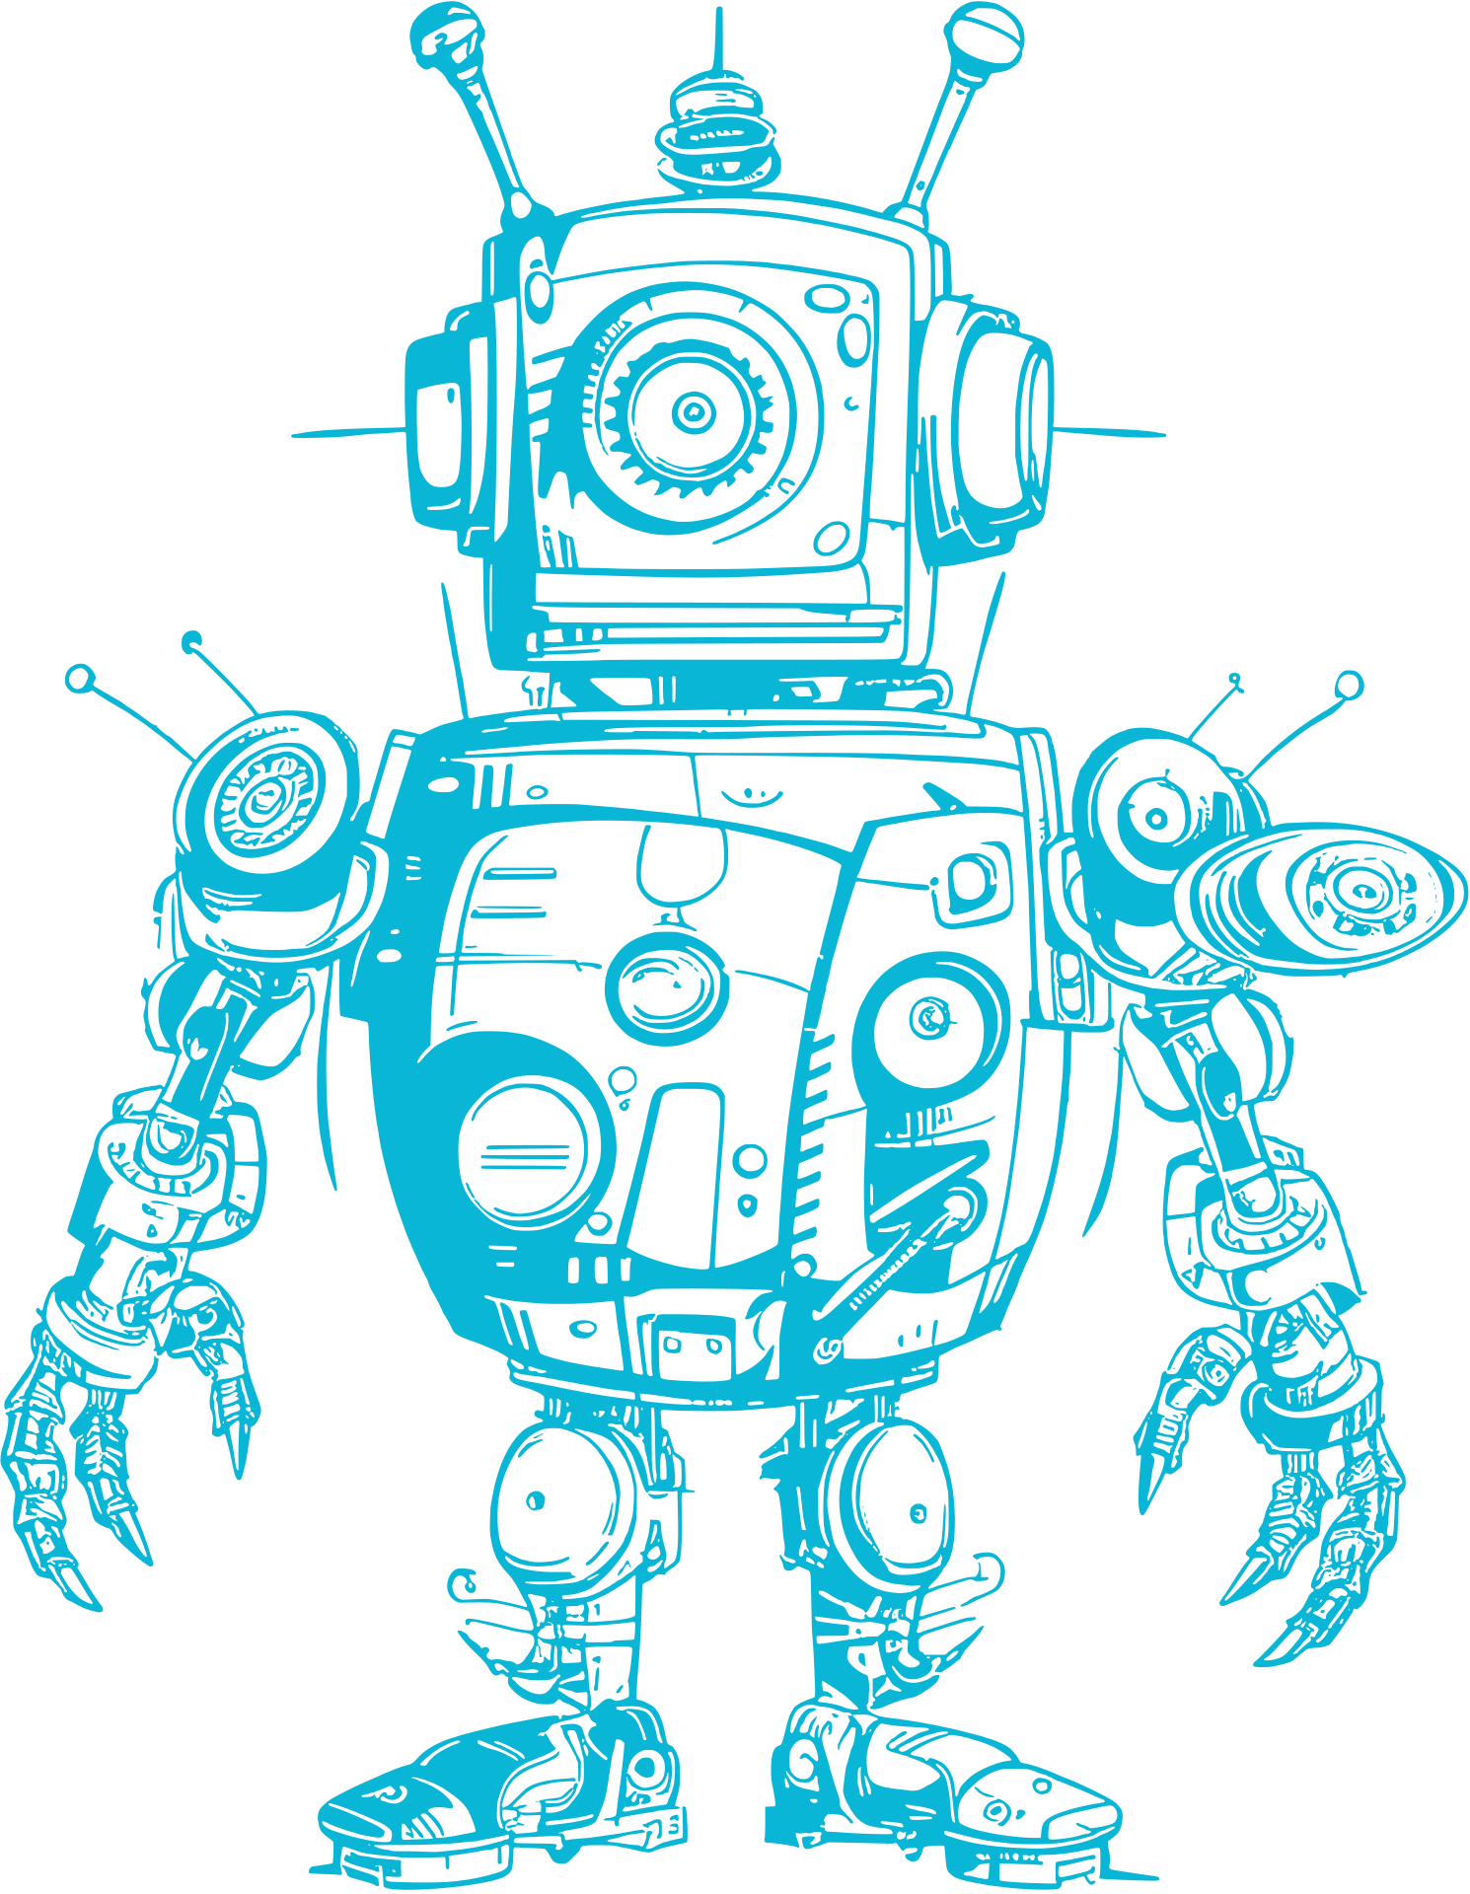

02
Abstract
- Objective: Predict diabetes using ML and DL algorithms.
- Algorithms: Logistic Regression, Random Forest, and Deep Learning models.
- Tools: Python, pandas, sklearn, TensorFlow.
- Key Results: High accuracy achieved with DL

Slide 4
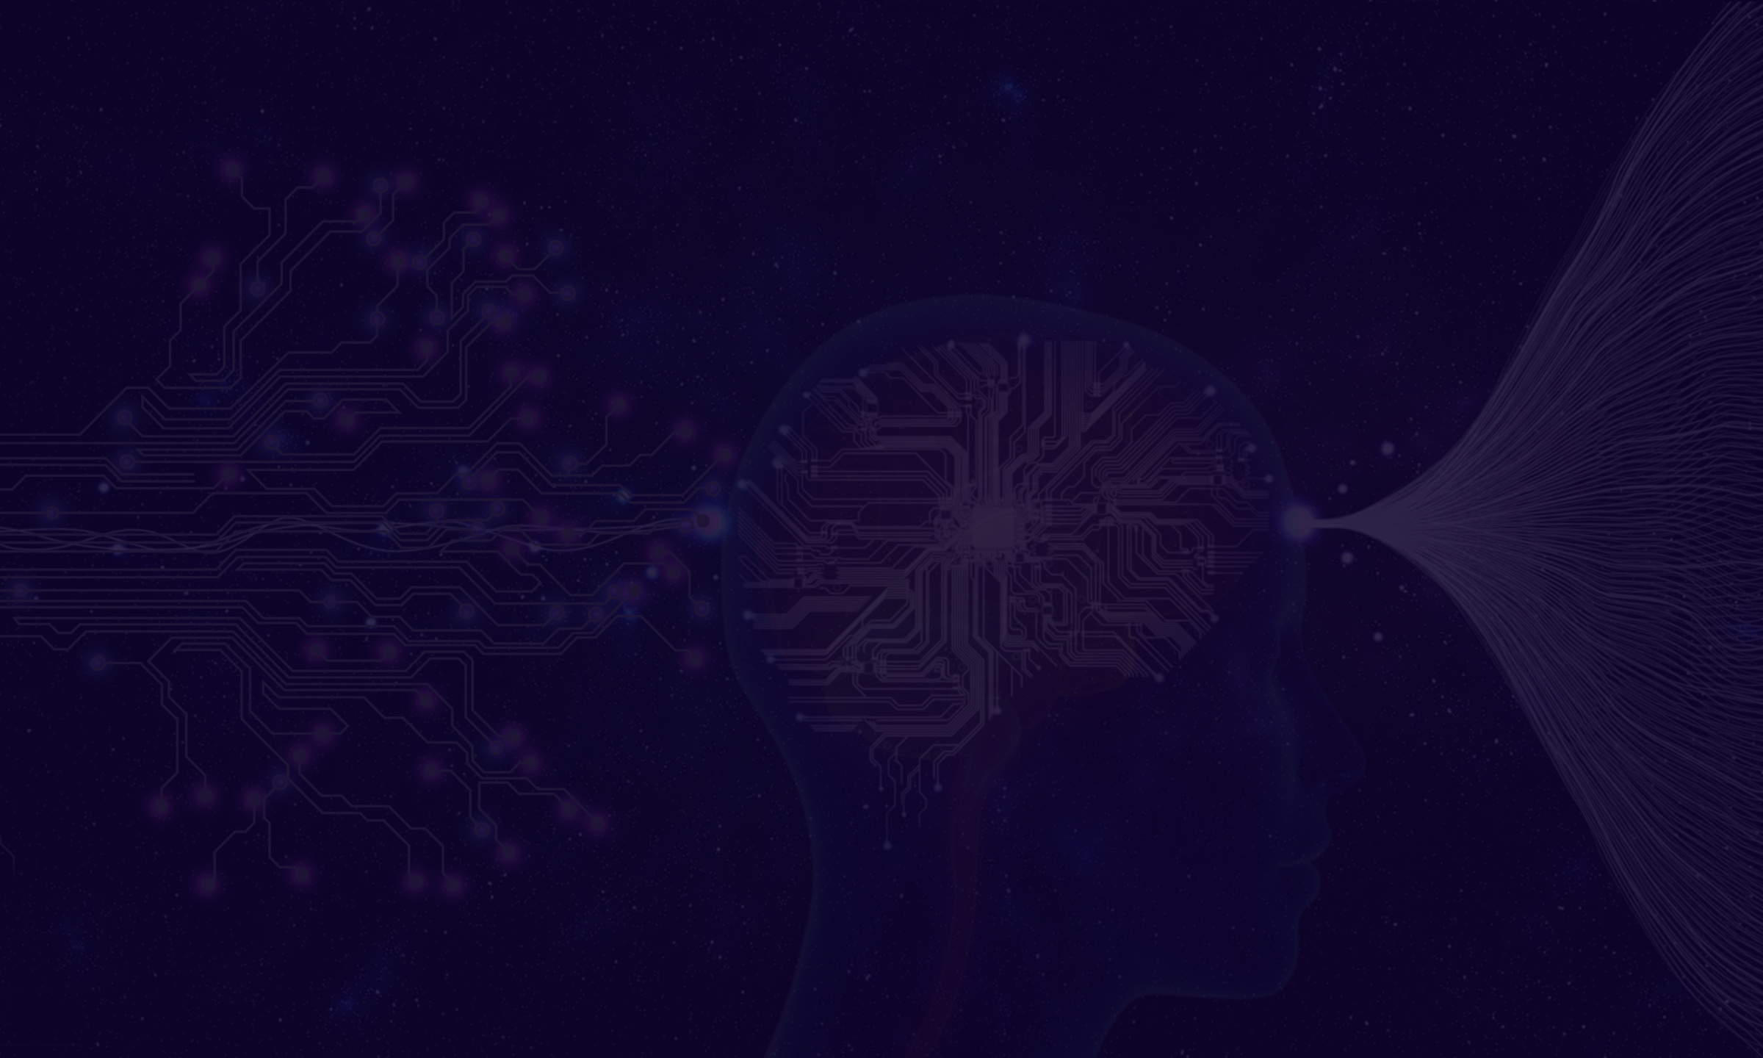

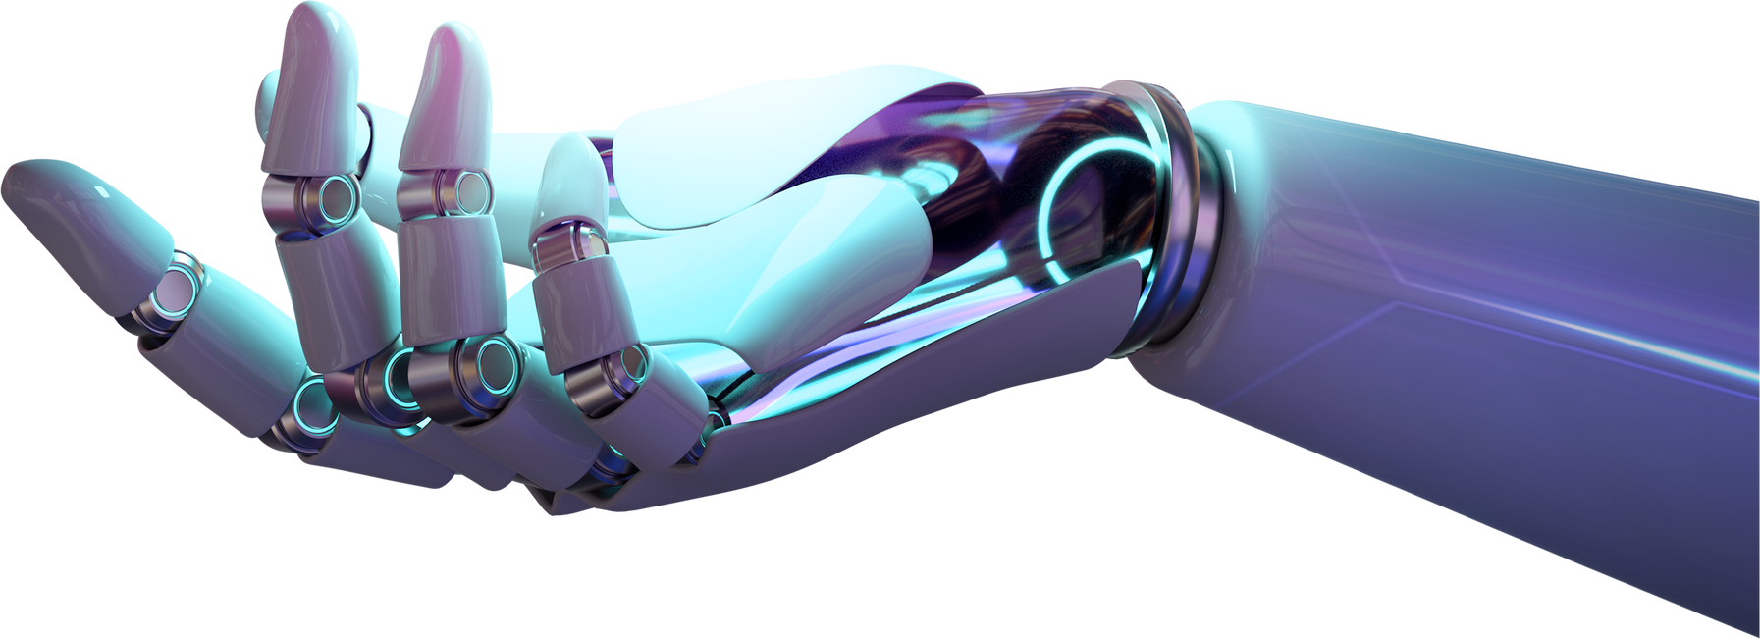
Introduction
Problem Statement
* Rising prevalence of diabetes globally.
*Need for early detection and accurate prediction.
Research Gap
-*Limited integration of ML and DL for prediction tasks.
03

Slide 5
04
Motivation
- Enhance healthcare efficiency and diagnosis precision.
Objective
- Broad: Predict diabetes with accuracy.
- Specific: Compare ML and DL performance.

Slide 6



05
Background Study
- Diabetes affects millions globally.
- Importance of early detection for prevention and treatment.
- ML/DL offers advanced techniques for disease prediction.

Slide 7


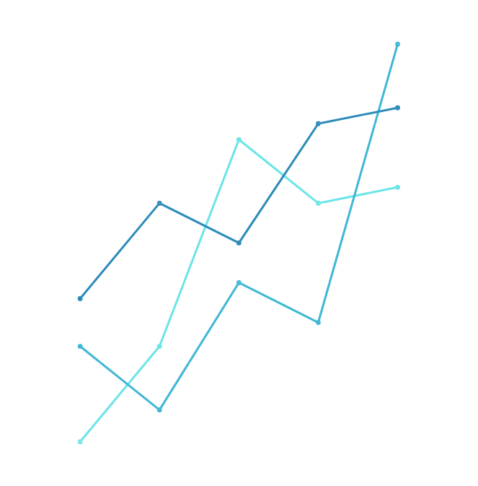
06
Literature Review
- Comparison of existing research on diabetes prediction.
- Strengths: High accuracy with certain ML models.
- Limitations: Scalability, limited use of DL.
- Contribution: Combining ML and DL for better results.

Slide 8




07
Methodology
Data Collection
Preprocessing
Model Selection
Publicly available diabetes.csv.
Cleaning and scaling.
ML Algorithms: Logistic Regression, Random Forest.
DL Model: Sequential with dense layers.

Slide 9


08
Planning & Execution
- Planning: Project timeline and task breakdown.
- Requirement Analysis: Tools: Python, TensorFlow.
- Design: Structured workflow for ML and DL models.
- Development: Model implementation and training.
- Testing: Evaluate models on test data.

Slide 10

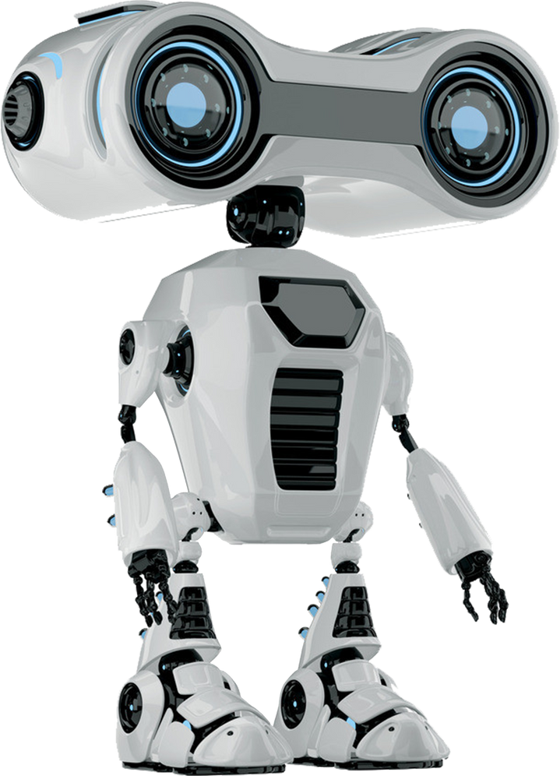
09
Data Analysis & Findings
- Positive Findings:
- Logistic Regression: Simplicity and interpretability.
- Random Forest: High accuracy and robustness.
- Deep Learning: Superior performance for large datasets.
- Negative Findings:
- Deep Learning requires more computation.
- Risk of overfitting without sufficient data.

Slide 11
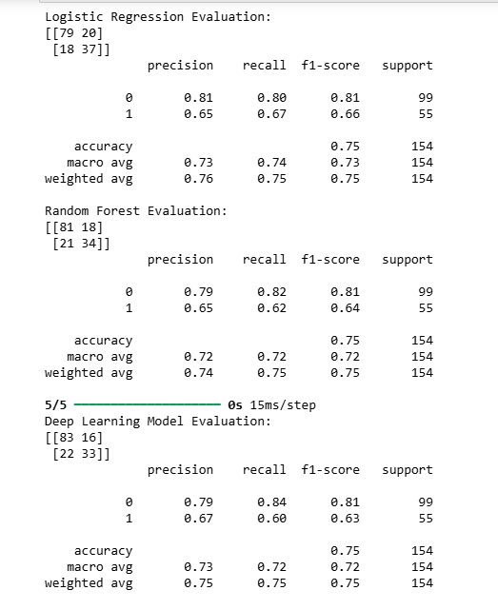
Output
10

Slide 12

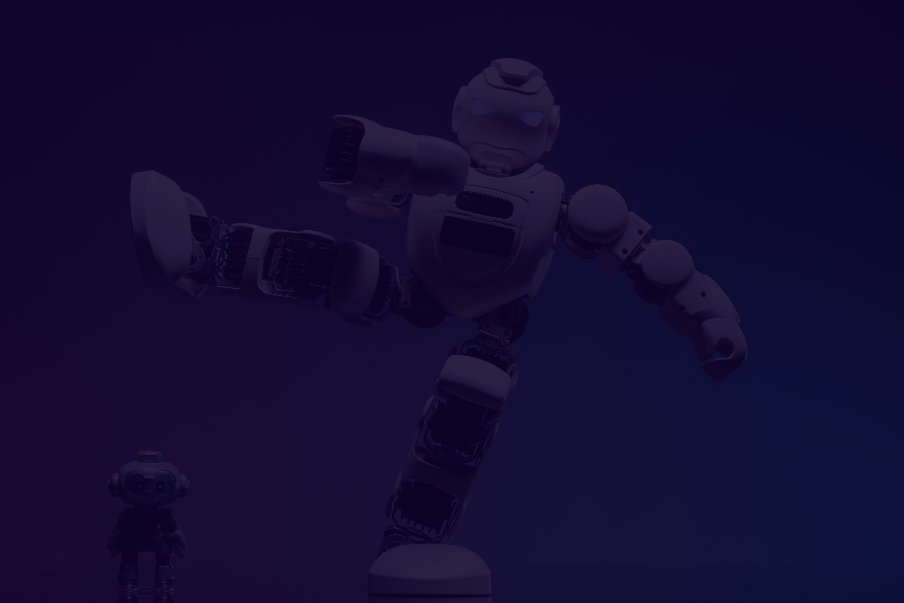
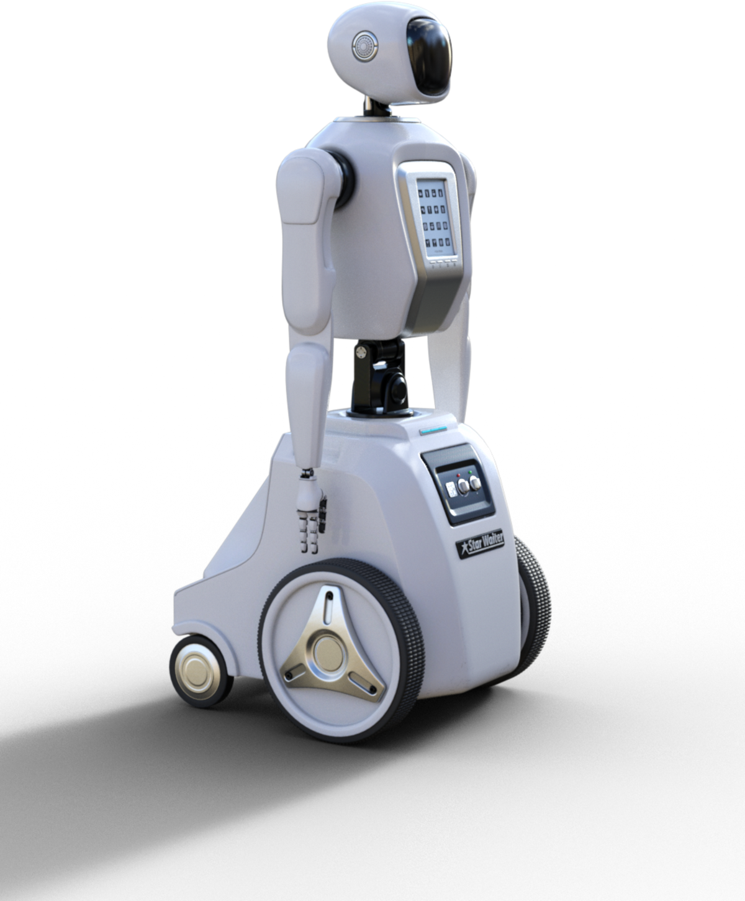
11
Conclusion
- Logistic Regression and Random Forest work well for small datasets.
- Deep Learning excels with complex patterns and scalability.
- Practical implications: Early and efficient diabetes prediction.

Slide 13
FAQ
Any questions?
Please ask!

Slide 14



Thank You!

